Slide 1
CN:CST31209 : Deep Learning and Big Data Intelligence
JING WEN
Spring 2021
Lecture 2:Optimization
Notes:
Where to put block multi-vector algorithms?
Percentage of Future Work
Diagram

Slide 2
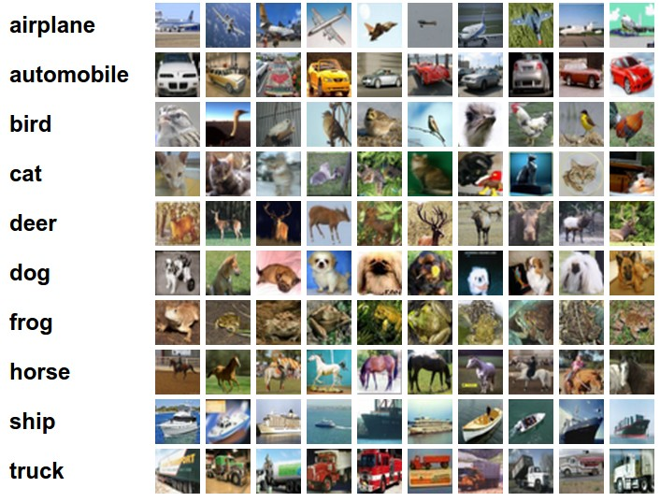
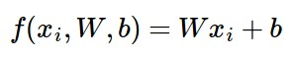
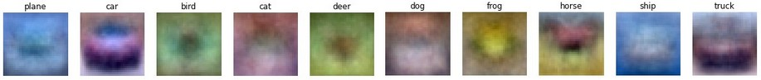
Last Time: Linear Classifier
Example trained weights of a linear classifier trained on CIFAR-10:

Slide 3
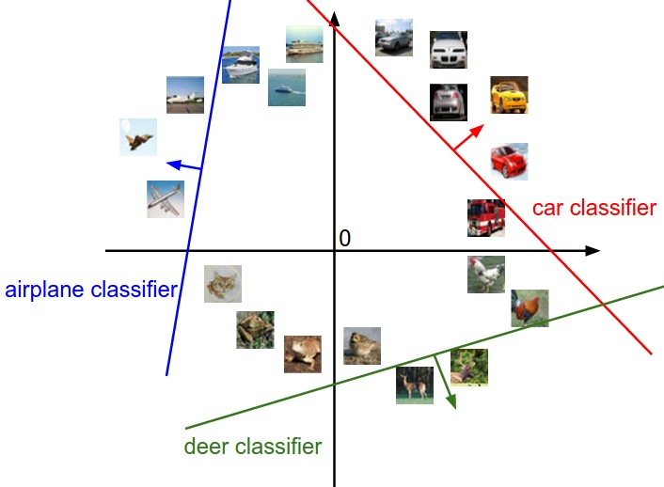

Interpreting a Linear Classifier
[32x32x3]
array of numbers 0...1
(3072 numbers total)

Slide 4
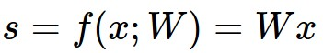
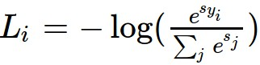
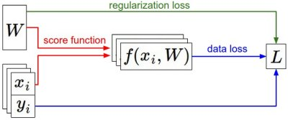

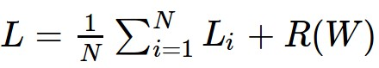
Last Time: Loss Functions
We have some dataset of (x,y)
We have a score function:
We have a loss function:
e.g.
Softmax
SVM
Full loss

Slide 5
Optimization

Slide 6
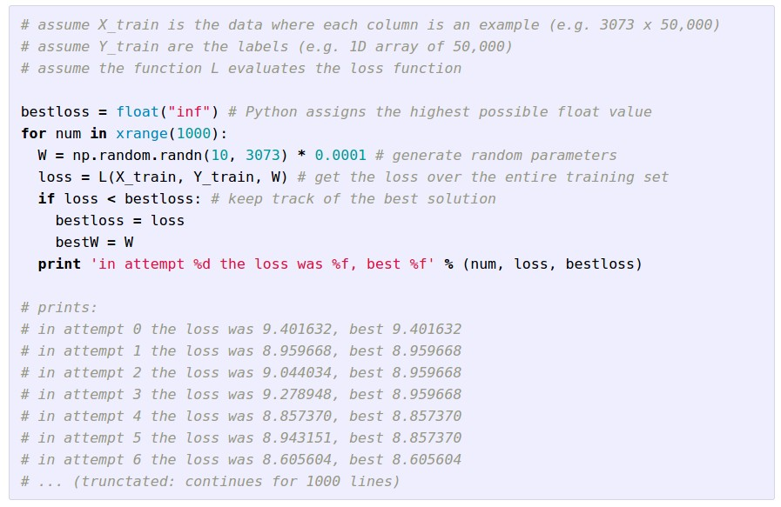
Strategy #1: A first very bad idea solution: Random search

Slide 7
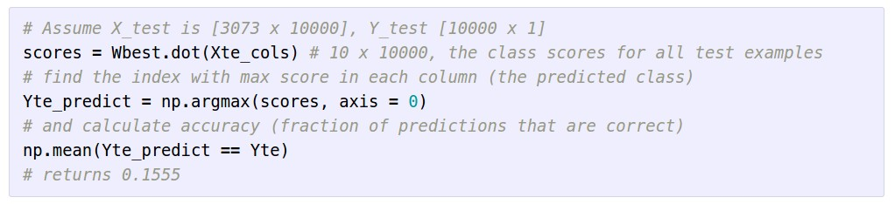
Lets see how well this works on the test set...
15.5% accuracy! not bad!
(State of the art is ~95%)

Slide 8


Slide 9


Slide 10
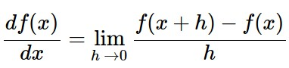
Strategy #2: Follow the slope
In 1-dimension, the derivative of a function:
In multiple dimensions, the gradient is the vector of (partial derivatives).

Slide 11
current W:
[0.34,
-1.11,
0.78,
0.12,
0.55,
2.81,
-3.1,
-1.5,
0.33,…]
loss 1.25347
gradient dW:
[?,
?,
?,
?,
?,
?,
?,
?,
?,…]

Slide 12
current W:
[0.34,
-1.11,
0.78,
0.12,
0.55,
2.81,
-3.1,
-1.5,
0.33,…]
loss 1.25347
W + h (first dim):
[0.34 + 0.0001,
-1.11,
0.78,
0.12,
0.55,
2.81,
-3.1,
-1.5,
0.33,…]
loss 1.25322
gradient dW:
[?,
?,
?,
?,
?,
?,
?,
?,
?,…]

Slide 13
current W:
[0.34,
-1.11,
0.78,
0.12,
0.55,
2.81,
-3.1,
-1.5,
0.33,…]
loss 1.25347
W + h (first dim):
[0.34 + 0.0001,
-1.11,
0.78,
0.12,
0.55,
2.81,
-3.1,
-1.5,
0.33,…]
loss 1.25322
gradient dW:
[-2.5,
?,
?,
?,
?,
?,
?,
?,
?,…]
(1.25322 - 1.25347)/0.0001
= -2.5

Slide 14
current W:
[0.34,
-1.11,
0.78,
0.12,
0.55,
2.81,
-3.1,
-1.5,
0.33,…]
loss 1.25347
W + h (second dim):
[0.34,
-1.11 + 0.0001,
0.78,
0.12,
0.55,
2.81,
-3.1,
-1.5,
0.33,…]
loss 1.25353
gradient dW:
[-2.5,
?,
?,
?,
?,
?,
?,
?,
?,…]

Slide 15
current W:
[0.34,
-1.11,
0.78,
0.12,
0.55,
2.81,
-3.1,
-1.5,
0.33,…]
loss 1.25347
W + h (second dim):
[0.34,
-1.11 + 0.0001,
0.78,
0.12,
0.55,
2.81,
-3.1,
-1.5,
0.33,…]
loss 1.25353
gradient dW:
[-2.5,
0.6,
?,
?,
?,
?,
?,
?,
?,…]
(1.25353 - 1.25347)/0.0001
= 0.6

Slide 16
current W:
[0.34,
-1.11,
0.78,
0.12,
0.55,
2.81,
-3.1,
-1.5,
0.33,…]
loss 1.25347
W + h (third dim):
[0.34,
-1.11,
0.78 + 0.0001,
0.12,
0.55,
2.81,
-3.1,
-1.5,
0.33,…]
loss 1.25347
gradient dW:
[-2.5,
0.6,
?,
?,
?,
?,
?,
?,
?,…]

Slide 17
current W:
[0.34,
-1.11,
0.78,
0.12,
0.55,
2.81,
-3.1,
-1.5,
0.33,…]
loss 1.25347
W + h (third dim):
[0.34,
-1.11,
0.78 + 0.0001,
0.12,
0.55,
2.81,
-3.1,
-1.5,
0.33,…]
loss 1.25347
gradient dW:
[-2.5,
0.6,
0,
?,
?,
?,
?,
?,
?,…]
(1.25347 - 1.25347)/0.0001
= 0

Slide 18
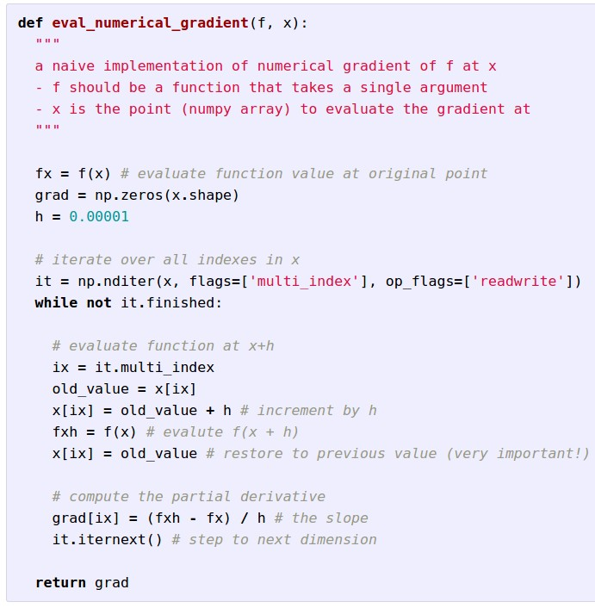
Evaluating the
gradient numerically

Slide 19
Evaluating the
gradient numerically
approximate
very slow to evaluate

Slide 20
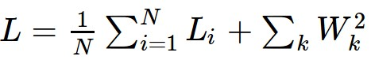
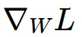
This is silly. The loss is just a function of W:
want

Slide 21
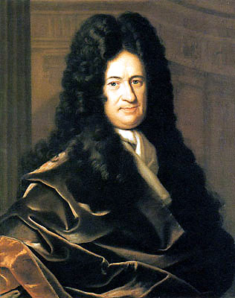
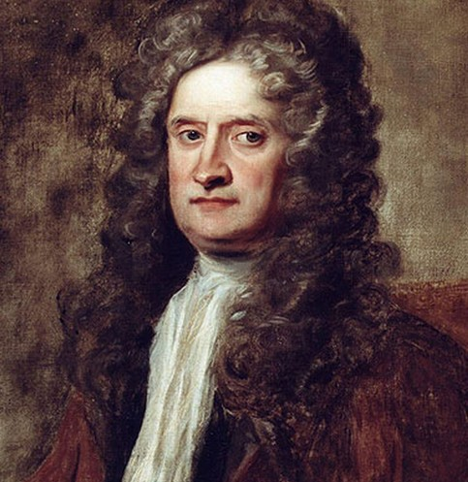
This is silly. The loss is just a function of W:
want
戈特弗里德·威廉·莱布尼茨

Slide 22

This is silly. The loss is just a function of W:
want
Calculus

Slide 23
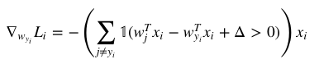
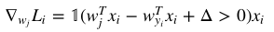
This is silly. The loss is just a function of W:
= ...

Slide 24
current W:
[0.34,
-1.11,
0.78,
0.12,
0.55,
2.81,
-3.1,
-1.5,
0.33,…]
loss 1.25347
gradient dW:
[-2.5,
0.6,
0,
0.2,
0.7,
-0.5,
1.1,
1.3,
-2.1,…]
dW = ...
(some function data and W)

Slide 25
In summary:
Numerical gradient: approximate, slow, easy to write
Analytic gradient: exact, fast, error-prone
=>
In practice: Always use analytic gradient, but check implementation with numerical gradient. This is called a gradient check.

Slide 26
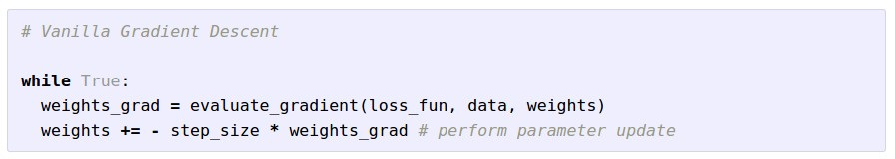
Gradient Descent

Slide 27
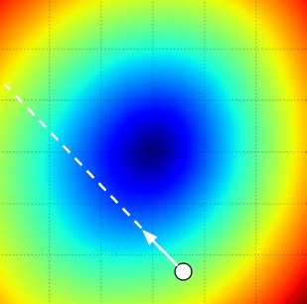
W_2
original W
W_1
negative gradient direction

Slide 28
Gradient Descent
BGD
MBGD
SGD

Slide 29
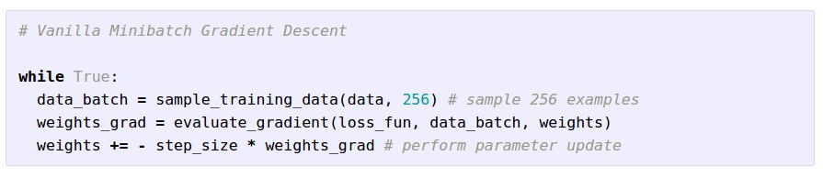
Mini-batch Gradient Descent
only use a small portion of the training set to compute the gradient.
Common mini-batch sizes are 32/64/128 examples
e.g. Krizhevsky ILSVRC ConvNet used 256 examples

Slide 30
Mini-batch Gradient Descent
如何更新权重?
假设输入两个数据，权重为5个
数据1（x1）： Loss = l1,gradients1=(1.5,−2.0,1.1,0.4,−0.9)
数据2（x2）： Loss = l2, gradients2=(1.2,2.3,−1.1,−0.8,−0.7)
则更新权重时两种方法：
求上面两个数据所求出来的梯度(gradients1, gradients2) 的平均值更新权重：
gradients_result = ( gradients1, gradients2)/2 = (1.35, 0.15, 0, -0.2, -0.8)
2. 求两个损失的平均值更新权重（tensorflow）

Slide 31
Mini-batch Gradient Descent
only use a small portion of the training set to compute the gradient.
we will look at more fancy update formulas
(momentum, Adagrad, RMSProp, Adam, …)
Common mini-batch sizes are 32/64/128 examples
e.g. Krizhevsky ILSVRC ConvNet used 256 examples

Slide 32
Minibatch updates
W_2
True negative gradient direction
W_1
original W

Slide 33
Mini-batch Gradient Descent
W_2
noisy gradient from minibatch
W_1
original W

Slide 34
Mini-batch Gradient Descent
W_2
True gradients in blue minibatch gradients in red
W_1
original W
Gradients are noisy but still make good progress on average

Slide 35
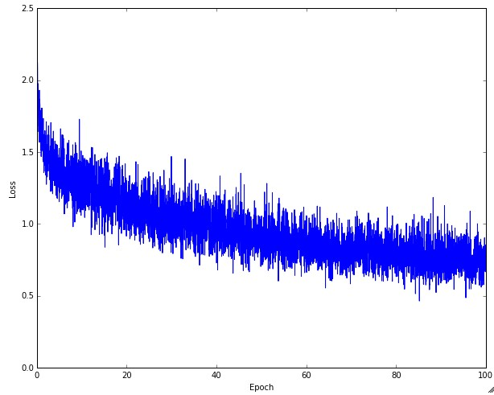
Mini-batch Gradient Descent
Example of optimization progress while training a neural network.
(Loss over mini-batches goes down over time.)

Slide 36
Another approach to poor gradients:
Q: What is the trajectory along which we converge towards the minimum with SGD?

Slide 37
Another approach to poor gradients:
Q: What is the trajectory along which we converge towards the minimum with SGD? very slow progress along flat direction, jitter along steep one

Slide 38
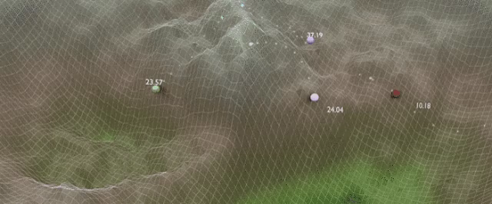
Stochastic Gradient Descent

Slide 39
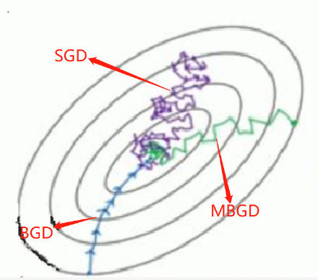

Slide 40
 | BGD（批量） | SGD（随机） | MBGD（小批量）
优点 | 非凸函数可保证收敛至全局最优解 | 计算速度快 | 计算速度快，收敛稳定
缺点 | 计算速度缓慢，不允许新样本中途进入 | 计算结果不易收敛，可能会陷入局部最优解中 | —

Slide 41
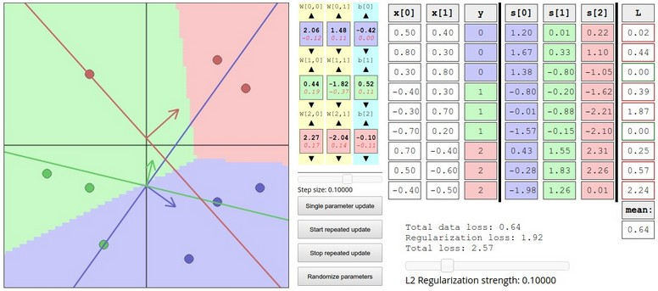
Interactive Web Demo time....
http://vision.stanford.edu/teaching/cs231n/linear-classify-demo/

Slide 42
You might be wondering…
W_2
Standard gradient
Can we compute this?
W_1

Slide 43
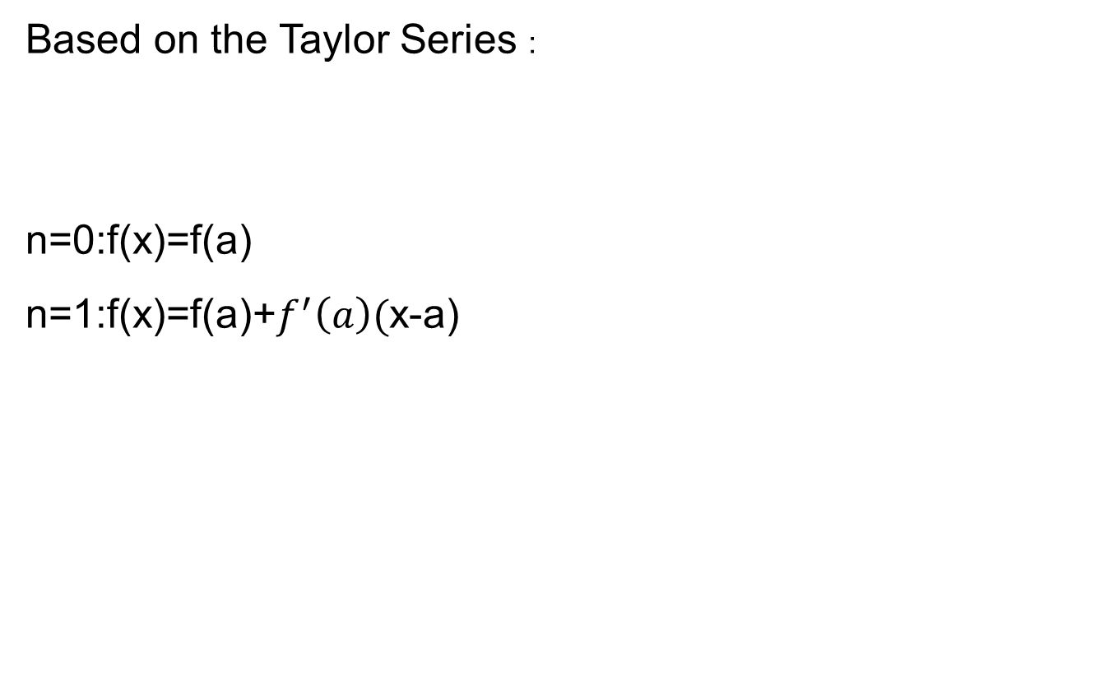
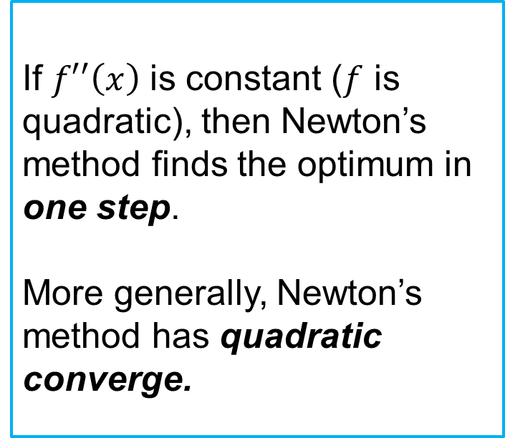
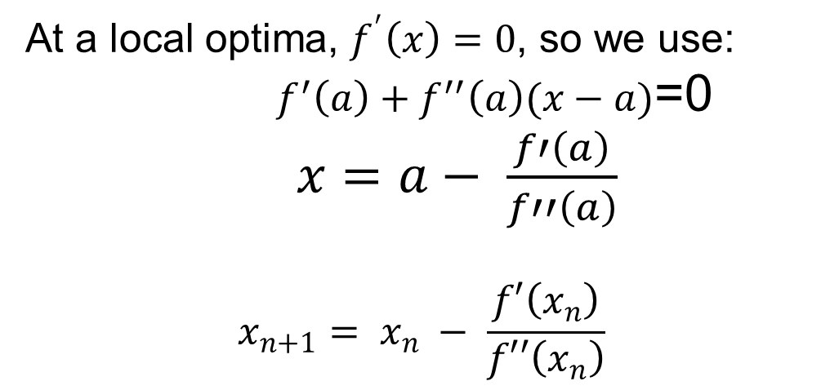
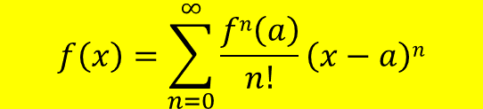
Newton’s method
Based on the Taylor Series :
n=0:f(x)=f(a)
n=1:f(x)=f(a)+$f^{′}\left(a\right)($x-a)
$$f\left(x\right)=\sum_{n=0}^{∞}{\frac{fn\left(a\right)}{n!}\left(x−a\right)n}$$
If $f′′\left(x\right)$ is constant ($f$ is quadratic), then Newton’s method finds the optimum in one step.
More generally, Newton’s method has quadratic converge.
At a local optima, $f^{′}\left(x\right)=0$, so we use:
${ f}^{′}\left(a\right)+f^{′′}\left(a\right)(x−a)$=0
$x=a− \frac{f′\left(a\right)}{f′′\left(a\right)}$
$$x_{n+1}= x_{n} − \frac{f′\left(x_{n}\right)}{f′′\left(x_{n}\right)}$$

Slide 44
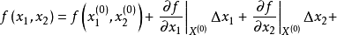
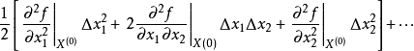
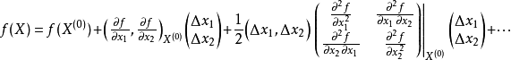
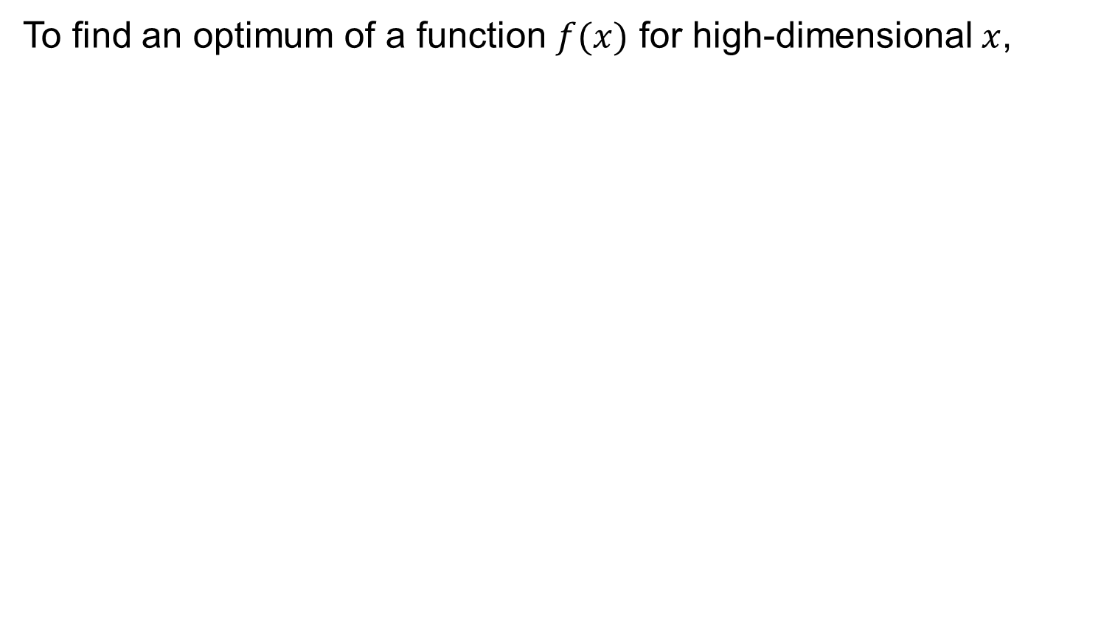
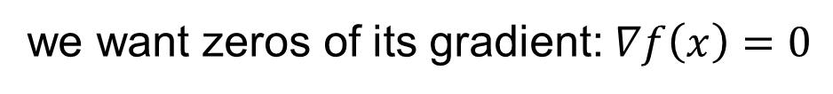
Newton’s method for gradients:
To find an optimum of a function $f(x)$ for high-dimensional $x$,
二元的泰勒展开式:
写成矩阵形式为：
we want zeros of its gradient: $∇f\left(x\right)=0$

Slide 45
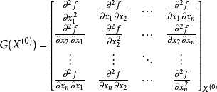
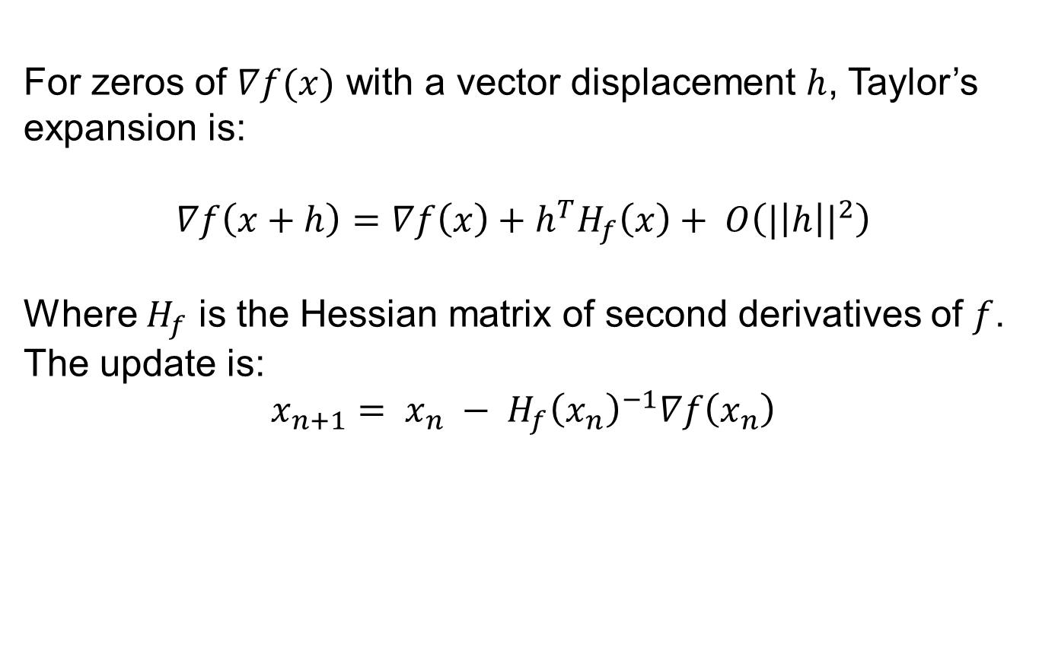
Newton’s method for gradients:
For zeros of $∇f(x)$ with a vector displacement $h$, Taylor’s expansion is:
$$∇f\left(x+h\right)=∇f\left(x\right)+h^{T}H_{f}\left(x\right)+ O\left({|\left|h\right||}^{2}\right)$$
Where $H_{f}$ is the Hessian matrix of second derivatives of $f$. The update is:
$$x_{n+1}= x_{n} − {H_{f}\left(x_{n}\right)}^{−1}∇f\left(x_{n}\right)$$
Hessian matrix

Slide 46
Newton step
W_2
Standard gradient
Newton gradient step
W_1

Slide 47
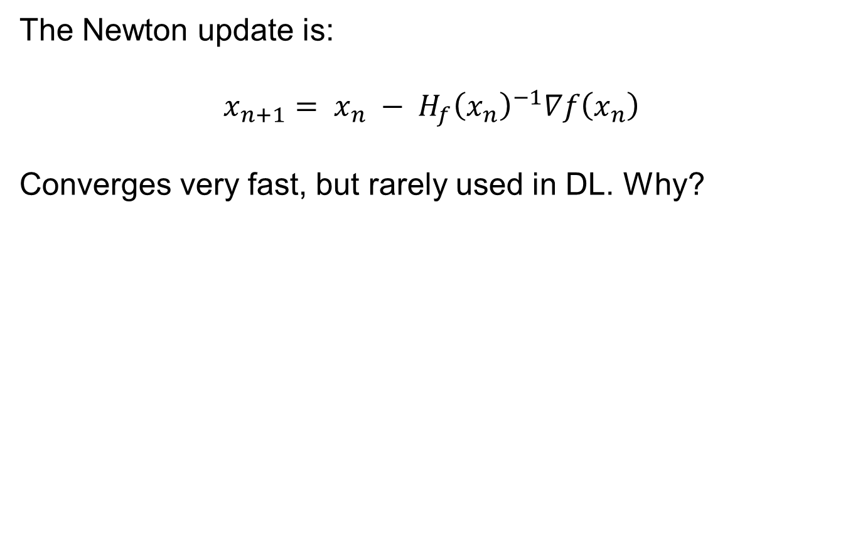
Newton’s method for gradients:
The Newton update is:
$$x_{n+1}= x_{n} − {H_{f}\left(x_{n}\right)}^{−1}∇f\left(x_{n}\right)$$
Converges very fast, but rarely used in DL. Why?

Slide 48
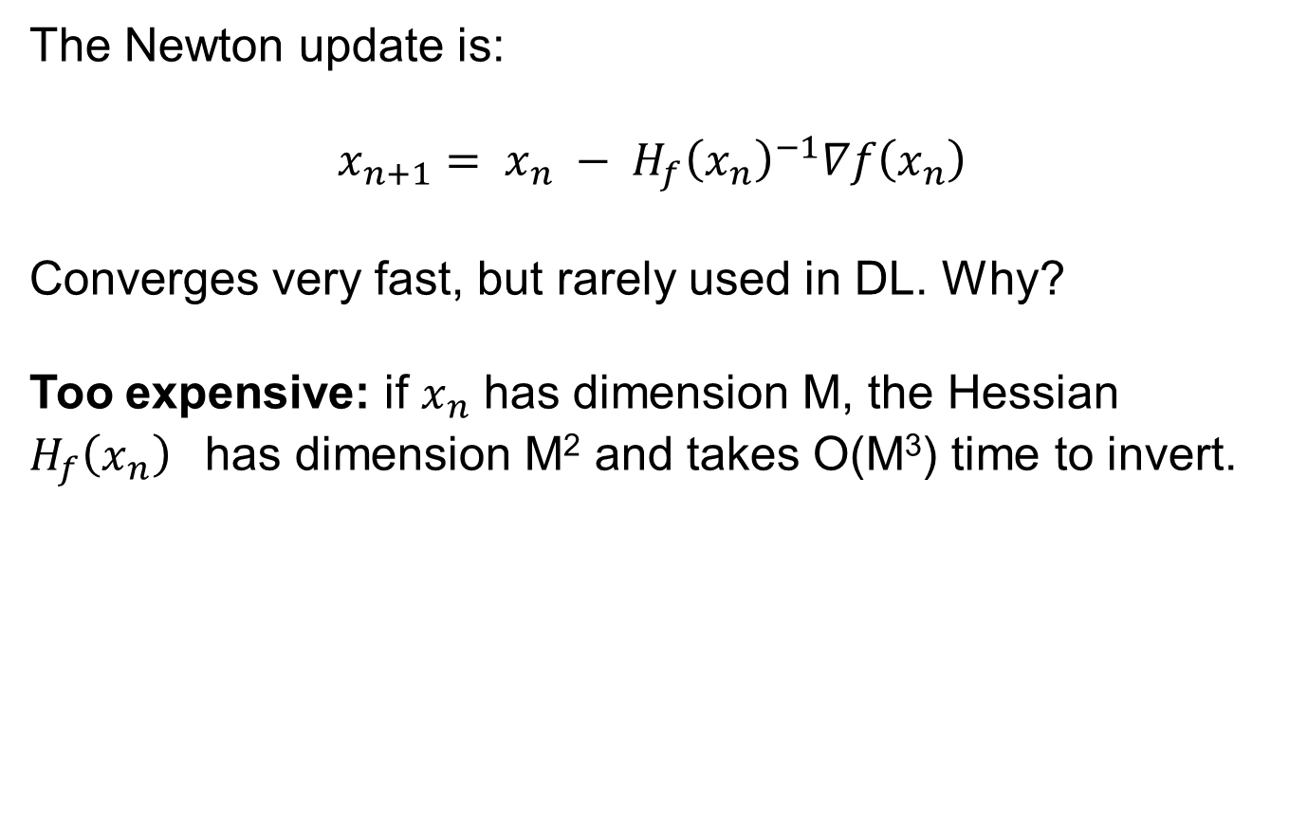
Newton’s method for gradients:
The Newton update is:
$$x_{n+1}= x_{n} − {H_{f}\left(x_{n}\right)}^{−1}∇f\left(x_{n}\right)$$
Converges very fast, but rarely used in DL. Why?
Too expensive: if $x_{n}$ has dimension M, the Hessian ${H_{f}\left(x_{n}\right)}^{}$has dimension M² and takes O(M³) time to invert.

Slide 49
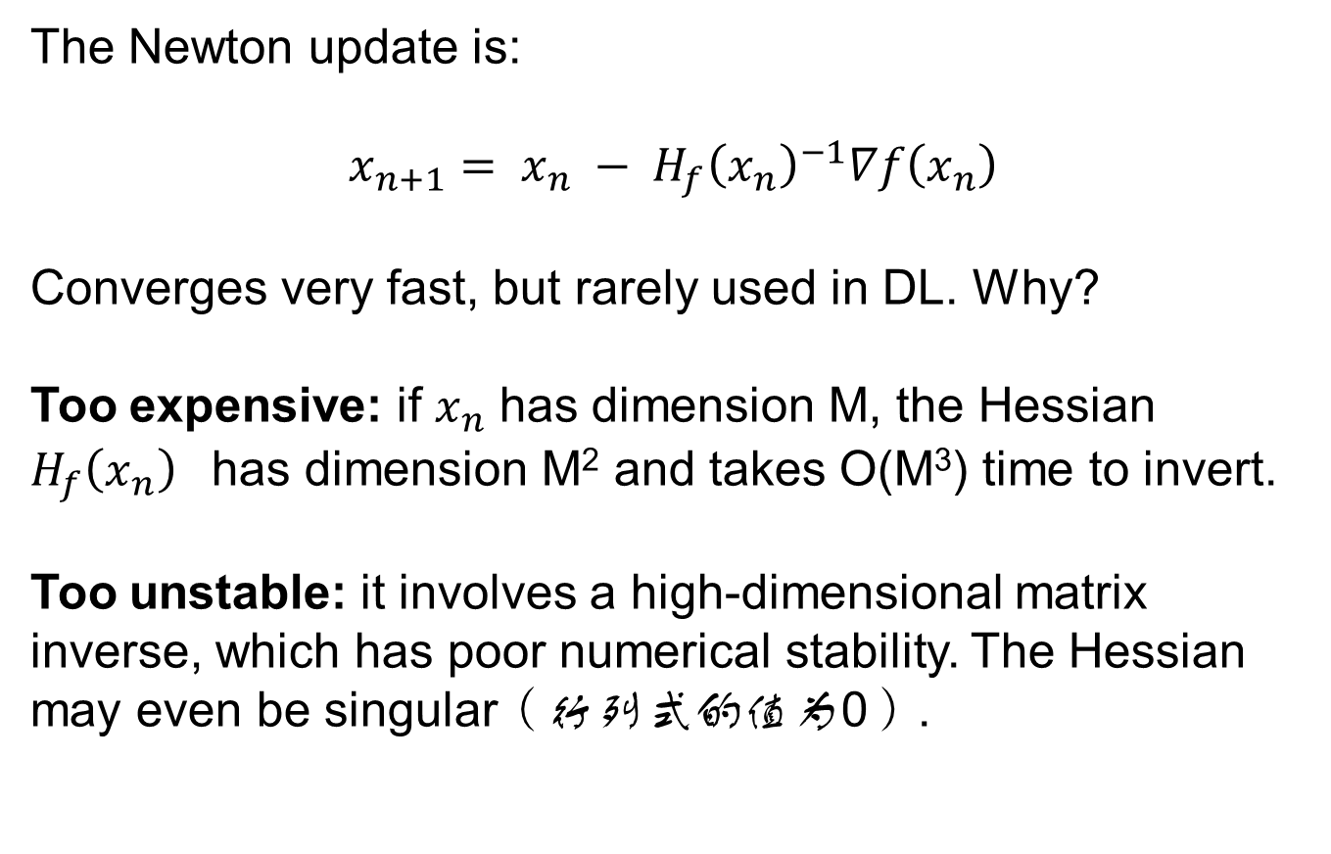
Newton’s method for gradients:
The Newton update is:
$$x_{n+1}= x_{n} − {H_{f}\left(x_{n}\right)}^{−1}∇f\left(x_{n}\right)$$
Converges very fast, but rarely used in DL. Why?
Too expensive: if $x_{n}$ has dimension M, the Hessian ${H_{f}\left(x_{n}\right)}^{}$has dimension M² and takes O(M³) time to invert.
Too unstable: it involves a high-dimensional matrix inverse, which has poor numerical stability. The Hessian may even be singular（行列式的值为0）.

Slide 50
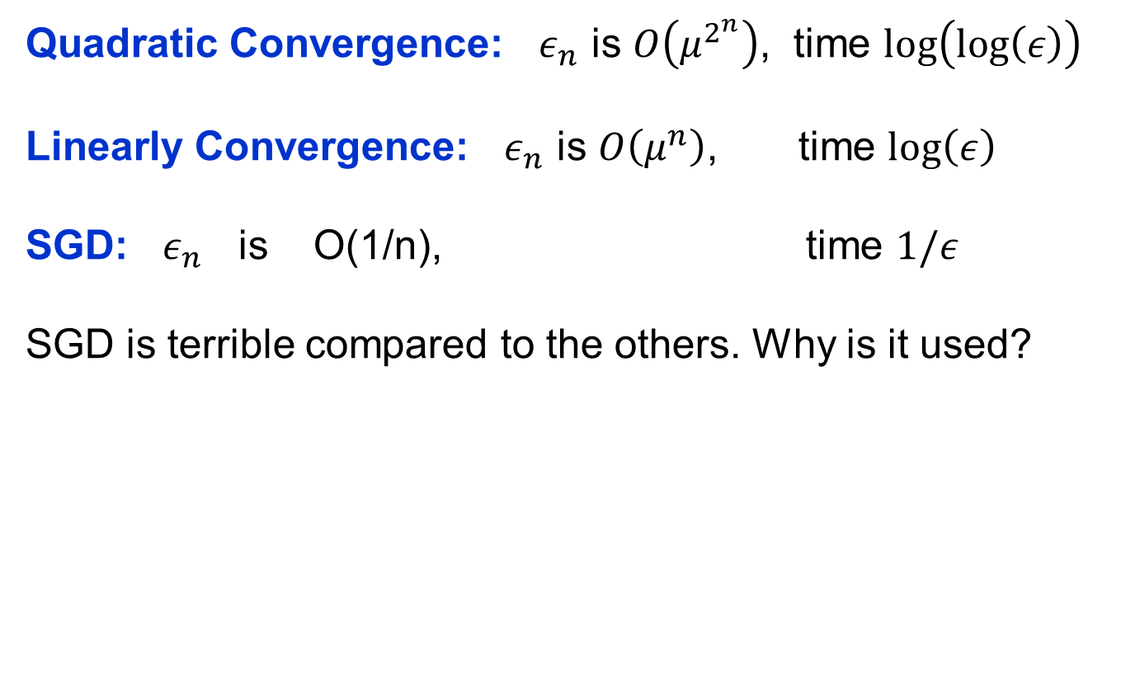
Convergence Comparison
Quadratic Convergence: $ε_{n}$ is $O\left(μ^{2^{n}}\right)$, time $\text{log}\left(log⁡\left(ε\right)\right)$
Linearly Convergence: $ε_{n}$ is $O\left(μ^{n}\right)$, time $\text{log}\left(ε\right)$
SGD: $ε_{n}$ is O(1/n), time $1/ε$
SGD is terrible compared to the others. Why is it used?

Slide 51
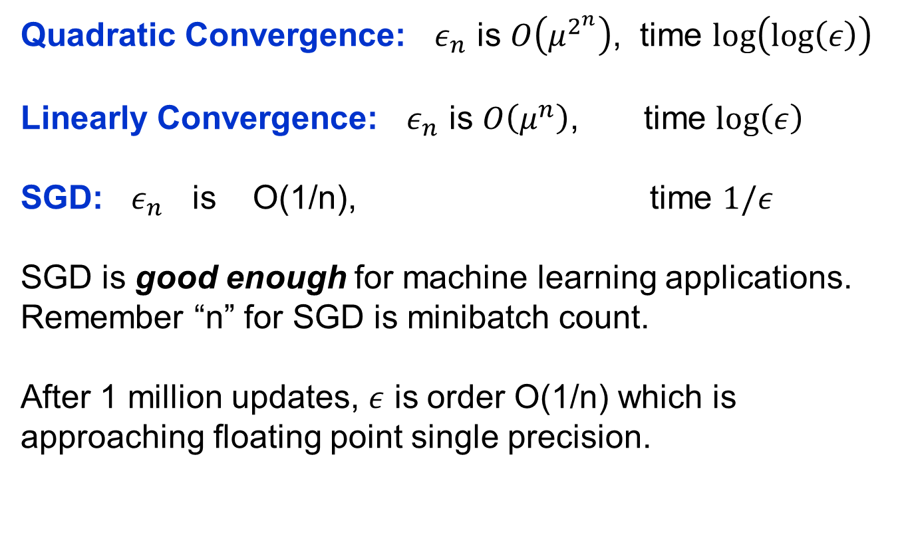
Convergence Comparison
Quadratic Convergence: $ε_{n}$ is $O\left(μ^{2^{n}}\right)$, time $\text{log}\left(log⁡\left(ε\right)\right)$
Linearly Convergence: $ε_{n}$ is $O\left(μ^{n}\right)$, time $\text{log}\left(ε\right)$
SGD: $ε_{n}$ is O(1/n), time $1/ε$
SGD is good enough for machine learning applications.
Remember “n” for SGD is minibatch count.
After 1 million updates, $ε$ is order O(1/n) which is approaching floating point single precision.

Slide 52
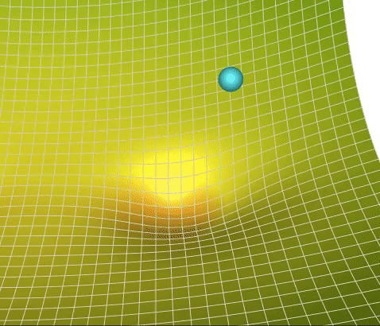
SGD

Slide 53

The effects of different update formulas
(image credits to Alec Radford)

Slide 54
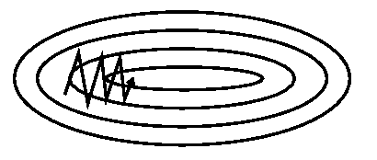
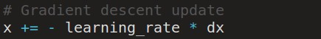
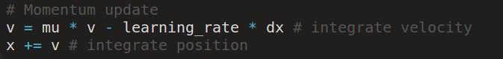
Momentum update
SGD
- Physical interpretation as ball rolling down the loss function + friction (mu coefficient).
- mu = usually ~0.5, 0.9, or 0.99 (Sometimes annealed over time, e.g. from 0.5 -> 0.99)
Notes:
参数更新时不仅考虑当前梯度值，而且加上了一个积累项（冲量），

Slide 55
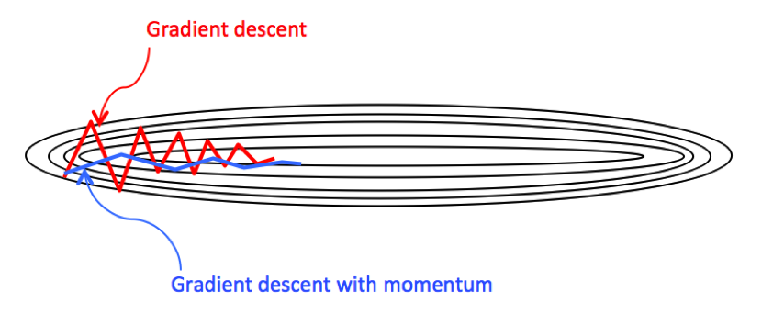
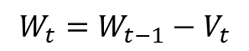
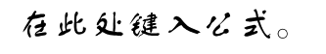
Momentum update
Allows a velocity to “build up” along shallow directions
Velocity becomes damped in steep direction due to quickly changing sign
$$Vt=μ∗V_{t−1}+\left(1−μ\right)∗l∗∇f\left(W_{t−1}\right)$$
$$W_{t}=W_{t−1}−V_{t}$$
Notes:
当梯度与冲量方向一致时，冲量项会增加，而相反时，冲量项减少

Slide 56
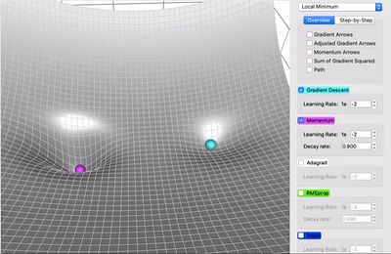
优点：
动量移动得更快(因为它积累的所有动量)
动量有机会逃脱局部极小值(因为动量可能推动它脱离局部极小值)。

Slide 57
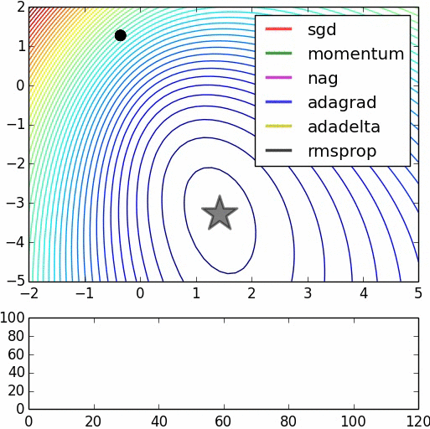
SGD
vs
Momentum
notice momentum
overshooting the target, but overall getting to the minimum much faster than vanilla SGD.

Slide 58

Nesterov Momentum(牛顿动量) update（NAG）
Ordinary momentum update:
momentum
step
修正后的方向
actual step
两次动量梯度方向
gradient
step

Slide 59

Nesterov Momentum update
Momentum update
Nesterov momentum update
“lookahead” gradient step (bit different than original)
momentum
step
momentum
step
actual step
actual step
gradient
step
Nesterov: the only difference...
$$Vt=μ∗V_{t−1}+\left(1−μ\right)∗l∗∇f\left(W_{t−1}\right)$$
$$Vt=μ∗V_{t−1}+\left(1−μ\right)∗l∗∇f\left(W_{t−1}+γV_{t−1}\right)$$
$$W_{t}=W_{t−1}−V_{t}$$

Slide 60

Nesterov Momentum update
$$Vt=μ∗V_{t−1}+\left(1−μ\right)∗l∗∇f\left(W_{t−1}+γV_{t−1}\right)$$

Slide 61






Nesterov Momentum update
$$Vt=μ∗V_{t−1}+\left(1−μ\right)∗l∗∇f\left(W_{t−1}+γV_{t−1}\right)$$
Slightly inconvenient…
usually we have :
Variable transform and rearranging saves the day:
Replace all thetas with phis, rearrange and obtain:
$${令∅}_{t}=θ_{t}$$
$$θ_{t}=θ_{t−1}−μv_{t−1}+(1+μ)v_{t}$$

Slide 62


Nesterov Momentum update
证明：
NAG=
Nesterov Accelerated Gradient

Slide 63
nag =
Nesterov Accelerated Gradient

Slide 64



[Duchi et al., 2011]
AdaGrad （Adaptive Gradient）update
Added element-wise scaling of the gradient based on the historical sum of squares in each dimension
$$S_{t}=S_{t−1}+∇W∙∇W$$
$$W_{t}=W_{t−1}−\frac{l}{sqrt\left(S_{t}\right)+ε}∇W$$

Slide 65
AdaGrad update
Q: What happens with AdaGrad?
Notes:
在前期，梯度累计平方和比较小，也就是r相对较小，则约束项较大，这样就能够放大梯度, 参数更新量变大; 随着迭代次数增多，梯度累计平方和也越来越大，即r也相对较大，则约束项变小，这样能够缩小梯度，参数更新量变小。

Slide 66
AdaGrad update
Q2: What happens to the step size over long time?
中后期，分母上梯度累加的平方和会越来越大，使得参数更新量趋近于0，使得训练提前结束，无法学习
Notes:
中后期，分母上梯度累加的平方和会越来越大，使得参数更新量趋近于0，使得训练提前结束，无法学习

Slide 67

http://github.com/lilipads/gradient_descent_viz
Notes:
在机器学习优化中，一些特征是非常稀疏的。 稀疏特征的平均梯度通常很小，所以这些特征的训练速度要慢得多。 解决这个问题的一种方法是为每个特征设置不同的学习率，但这很快就会变得混乱。 更好地避开鞍点 Adagrad 解决这个问题的思路是: 你已经更新的特征越多，你将来更新的就越少，这样就有机会让其它特征(例如稀疏特征)赶上来。 用可视化的术语来说，更新这个特征的程度即在这个维度中移动了多少，这个概念由梯度平方的累积和表达。 注意在上面的一步一步的网格插图中，如果没有重新缩放调整(1b) ，球大部分会垂直向下移动; 如果有调整(1d) ，它会沿对角线方向移动。

Slide 68

red:adagrad
Notes:
adagrad过鞍点后速度仍很慢

Slide 69




RMSProp update
[Tieleman and Hinton, 2012]
$$S_{t}=S_{t−1}+∇W∙∇W$$
$$S_{t}=βS_{t−1}+（1−β）∇W∙∇W$$
$$W_{t}=W_{t−1}−\frac{l}{sqrt\left(S_{t}\right)+ε}∇W$$
Notes:
AdaGrad 的问题在于它非常慢。 这是因为梯度的平方和只会增加而不会减小。 Rmsprop (Root Mean Square Propagation)通过添加衰减因子来修复这个问题。，并使得其在非凸设定下效果更好

Slide 70

Introduced in a slide in Geoff Hinton’s Coursera class, lecture 6

Slide 71

Introduced in a slide in Geoff Hinton’s Coursera class, lecture 6
Cited by several papers as:

Slide 72

adagrad
rmsprop

Slide 73

Adam update
[Kingma and Ba, 2014]
(incomplete, but close)
Notes:
Adam (Adaptive Moment Estimation)同时兼顾了动量和 RMSProp 的优点。 Adam在实践中效果很好，因此在最近几年，它是深度学习问题的常用选择。 Adam 的速度来自于动量和RMSProp 适应不同方向的梯度的能力

Slide 74
Adam update
[Kingma and Ba, 2014]
(incomplete, but close)
momentum
RMSProp-like
Looks a bit like RMSProp with momentum

Slide 75
Adam update
[Kingma and Ba, 2014]
(incomplete, but close)
momentum
RMSProp-like
Looks a bit like RMSProp with momentum

Slide 76

Adam update
[Kingma and Ba, 2014]
momentum
bias correction
(only relevant in first few iterations when t is small)
RMSProp-like
The bias correction compensates for the fact that m,v are initialized at zero and need some time to “warm up”.

Slide 77

SGD, SGD+Momentum, Adagrad, RMSProp, Adam all have learning rate as a hyperparameter.
Q: Which one of these learning rates is best to use?

Slide 78


SGD, SGD+Momentum, Adagrad, RMSProp, Adam all have learning rate as a hyperparameter.
=> Learning rate decay over time!
step decay:
e.g. decay learning rate by half every few epochs.
exponential decay:
1/t decay:
Notes:
离散下降(discrete staircase)
每 t 轮学习，学习率减半
指数减缓
学习率按训练轮数增长指数差值递减
分数减缓(1/t decay)

Slide 79
Gradient Descent Visualization
https://github.com/lilipads/gradient_descent_viz

Slide 80
Summary
Simple Gradient Methods like SGD can make adequate progress to an optimum when used on minibatches of data.
Second-order methods make much better progress toward the goal, but are more expensive and unstable.
Convergence rates: quadratic, linear, O(1/n).
Momentum: is another method to produce better effective gradients.
ADAGRAD, RMSprop diagonally scale the gradient. ADAM scales and applies momentum.

